Slide 1
QuantConnect Alpha Strategy
Bringing algo-trading closer to non-professional investors
Batch 3A – Group 1

Slide 2
Roadmap
Survey
Python
QuantConnect
Refine trading strategies
Trading
Proprietary
Capital
(Income Source 2)
1
3
5
2
4
6
Development of long and short term trading strategy
Submit on Alpha Stream
(Income Source 1)
Fund Management
Business
(Income Source 3)

Slide 3
1.Trading Strategy as a Service

Slide 4
New Way of Trading/Investing
Professional trading/investment
QuantConnect
Alpha Market
Personal trading/investment
QuantConnect is a platform for :
Algo-Trading;
Analytics/Research;
Trading strategy marketplace.

Slide 5
2.Understanding our client

Slide 6

Persona Infographics
Excess Fund Seeking:
Profile:
Chan Kim Ming
Email: 2701ckm@gmail.com
Age: 50+
Job: Professional Engineer
Quotes:
“…tried trading on own, but returns had been sporadic. Will be good if there is a systematic way of trading with consistency in return.”
Age
21 years old & above
risk adjusted returns from trading.
investment in financial instruments using trading strategies which can be repeated over time to generate returns.
trading strategies which emphasize capital growth.
Location
Global
Tech Savvy:
OK
Tony Goh
Email: tony@jnp.com.sg
Age: 40+
Job: Sales Manager
Quotes:
“…has been doing manual trading. Heard about algo-trading. Will tried out if know how.”
Yes
Yea
Sure

Slide 7

Survey Insights
Lack Time
01
Annualized return rate at least 3% to 10%
35% knows about Algo-trading
06
02
Interest in US market
1 - Equities
2 - ETFs
3 - Crypto-currencies
4 -REITs
05
Concern strategy’s capability in meeting profit
target
03
04
Subscription fee level USD 3-5 per month (per USD 10K invested)

Slide 8
3. QuantConnect Alpha Market
A typical case of strategy selection

Slide 9
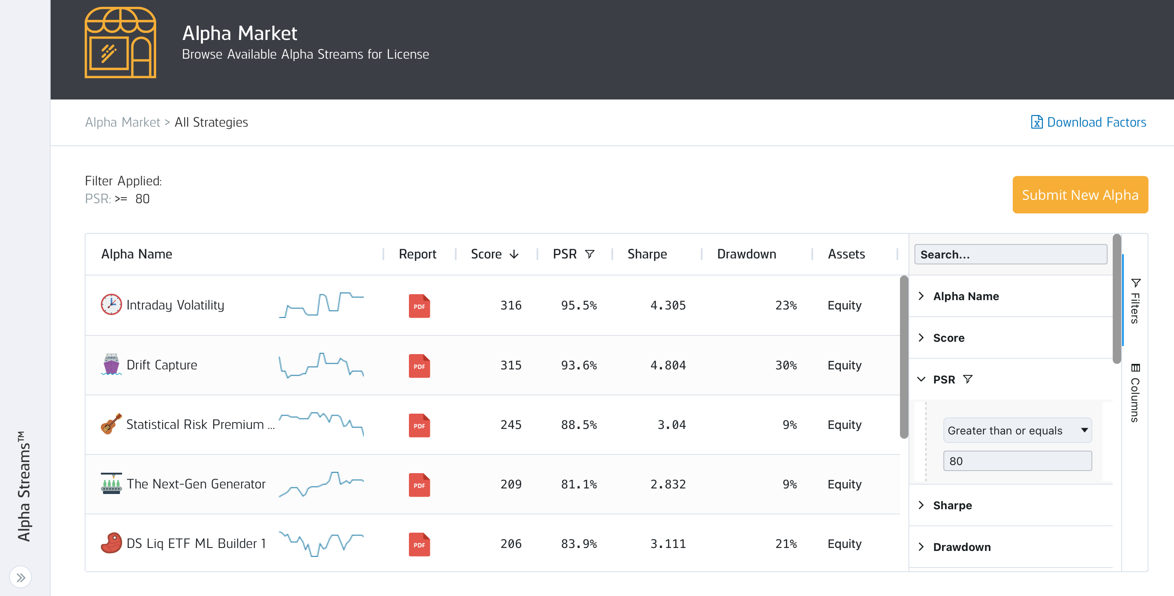
Strategy selection on Alpha Market

Slide 10
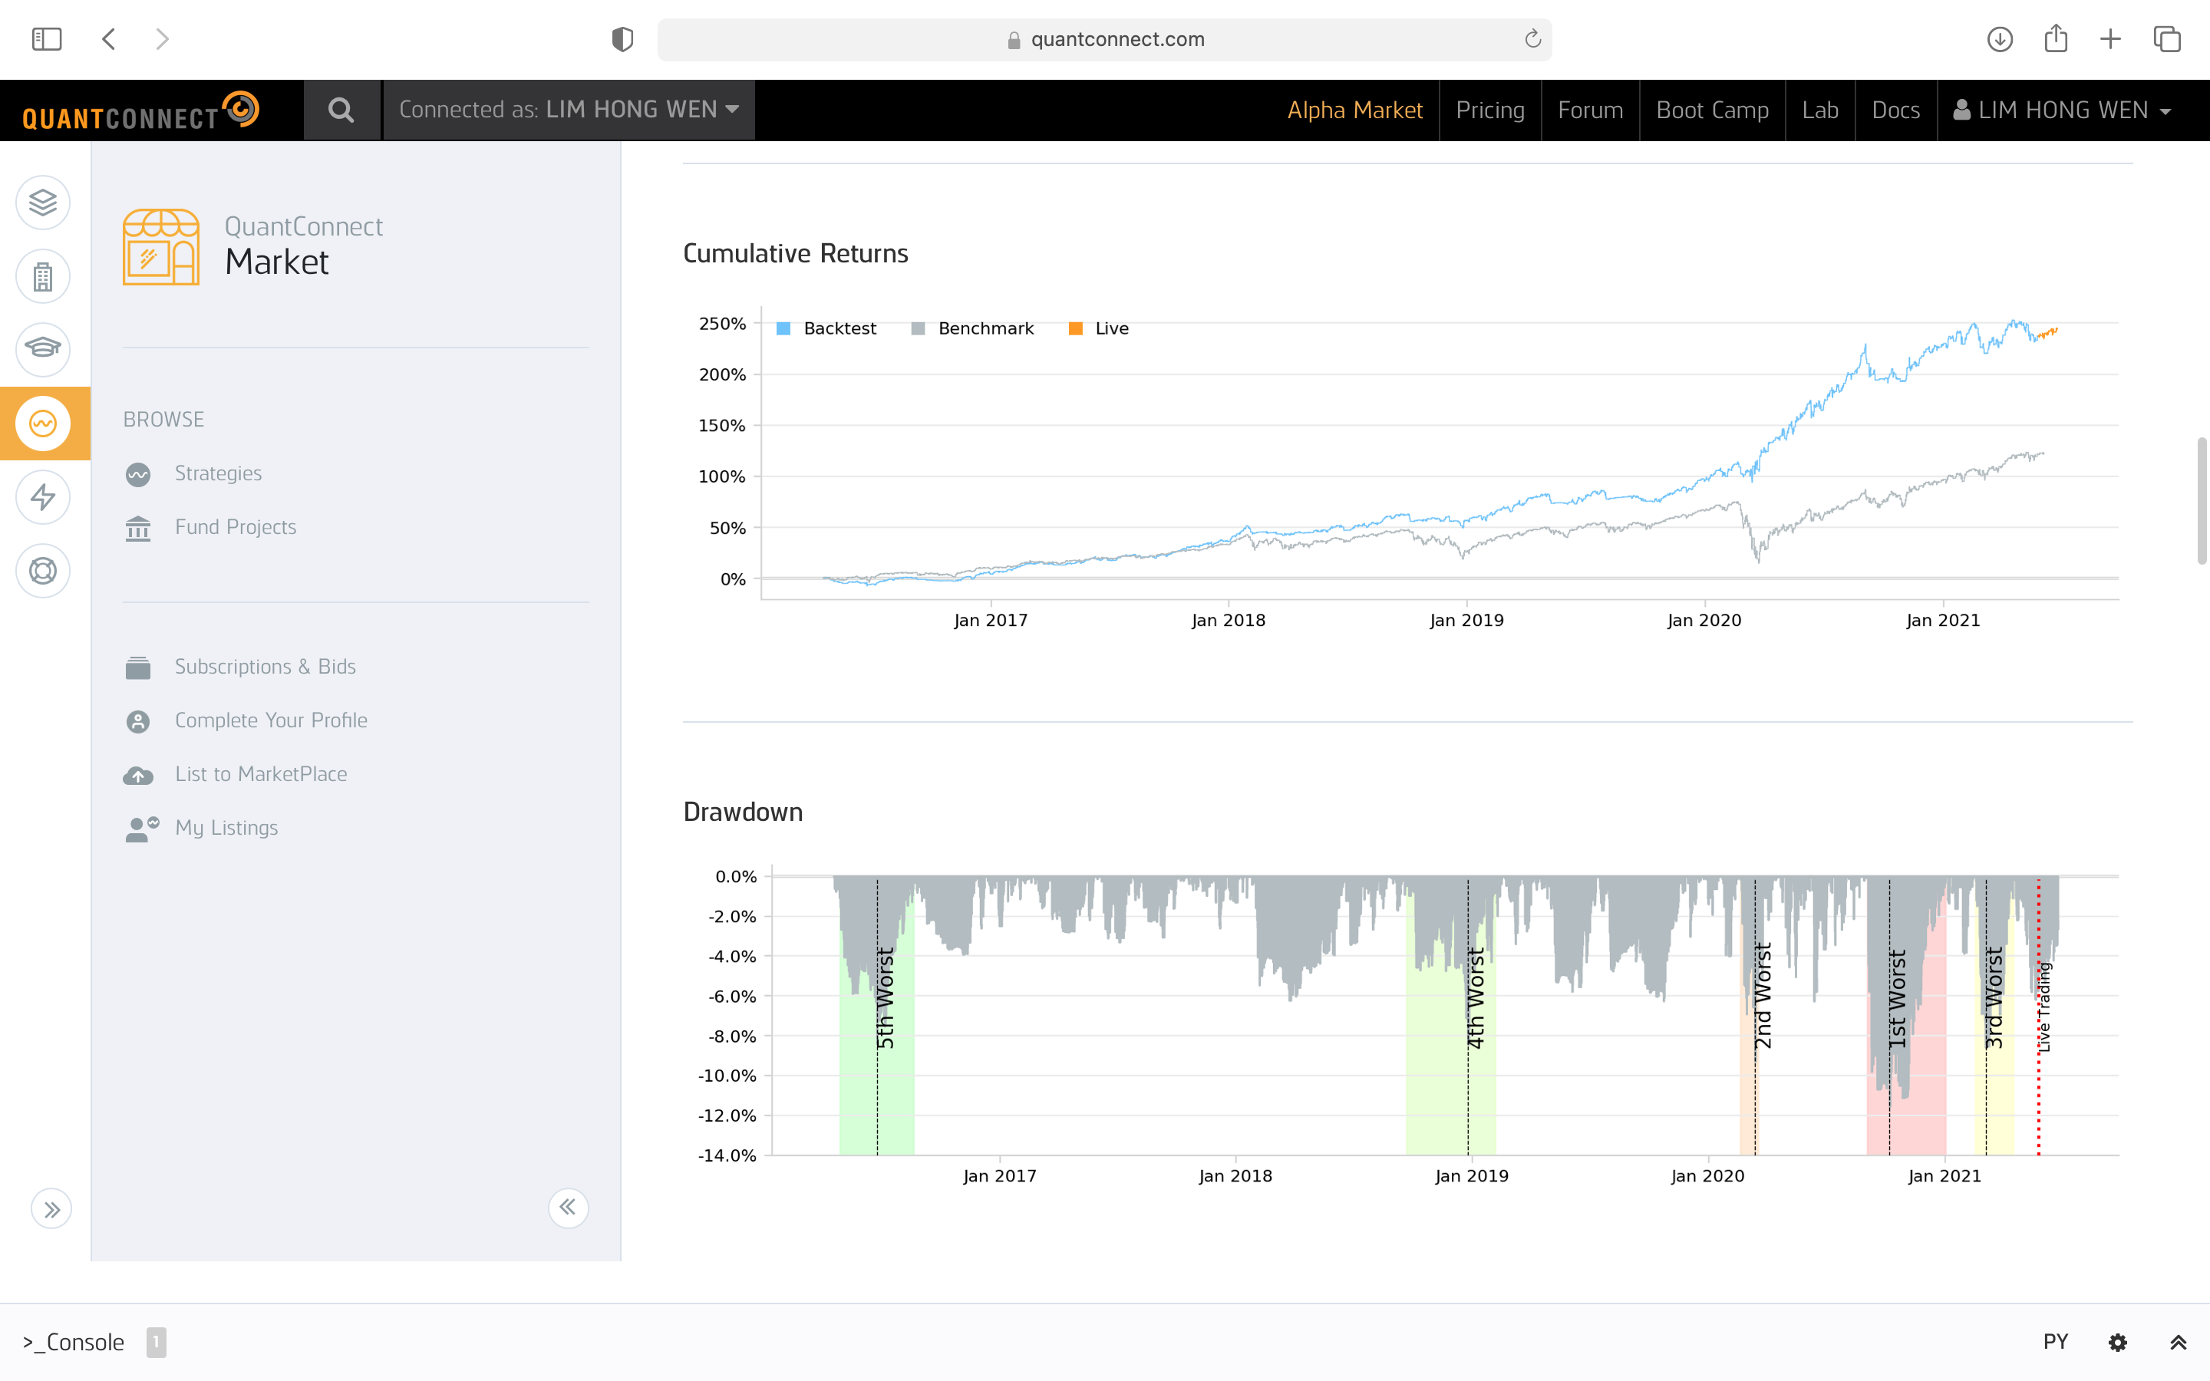
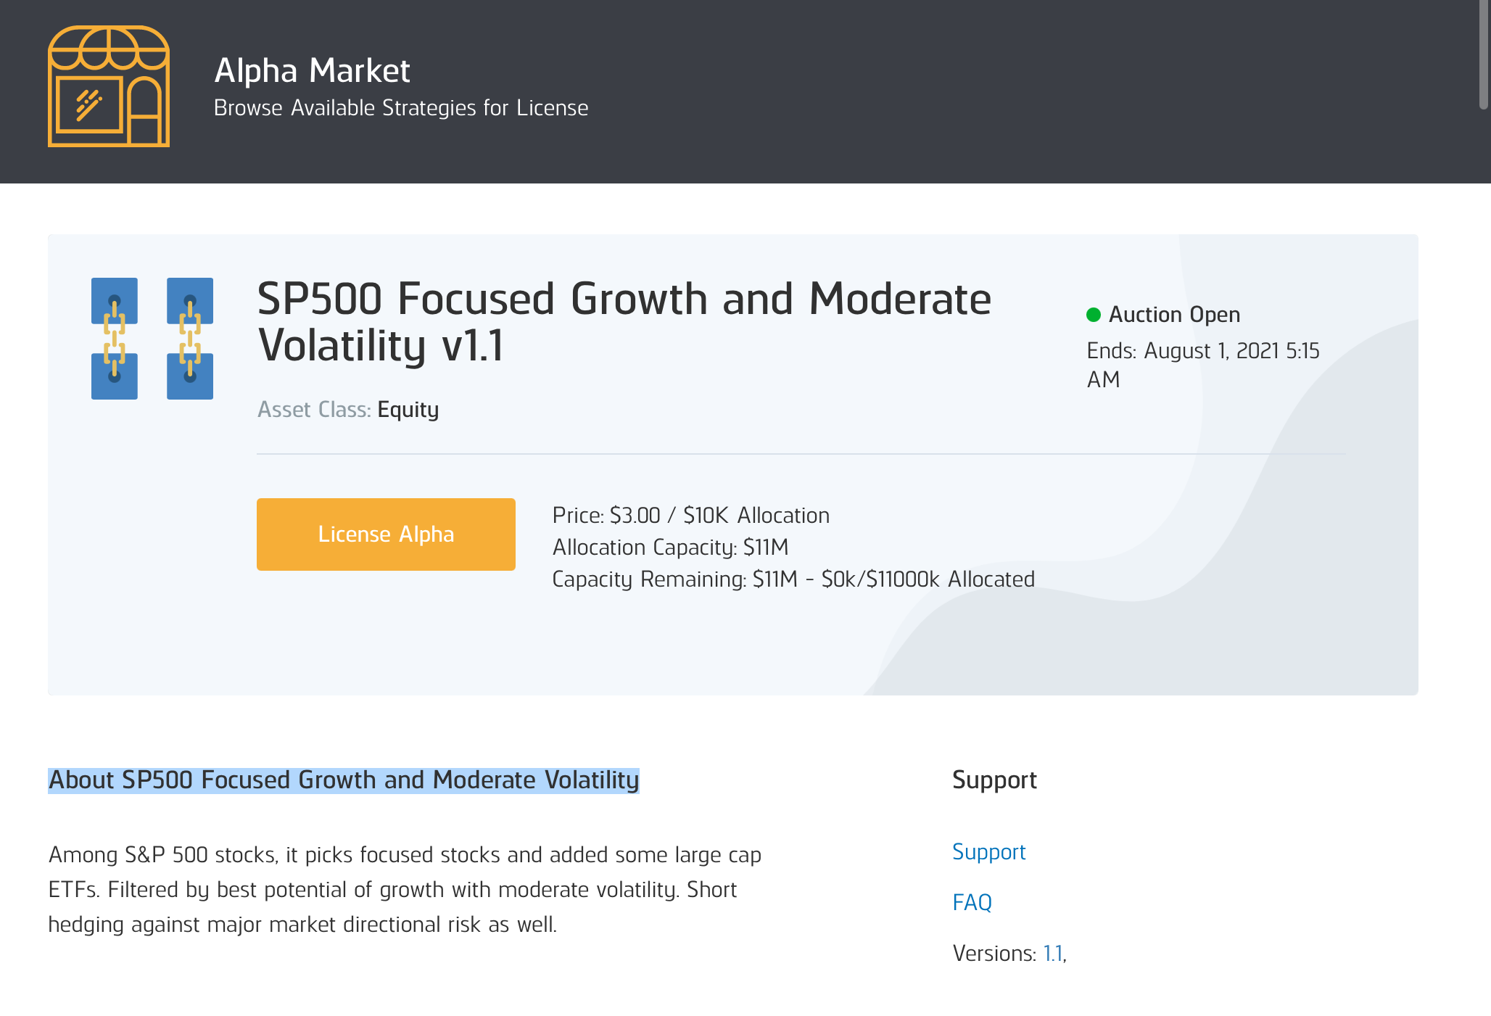
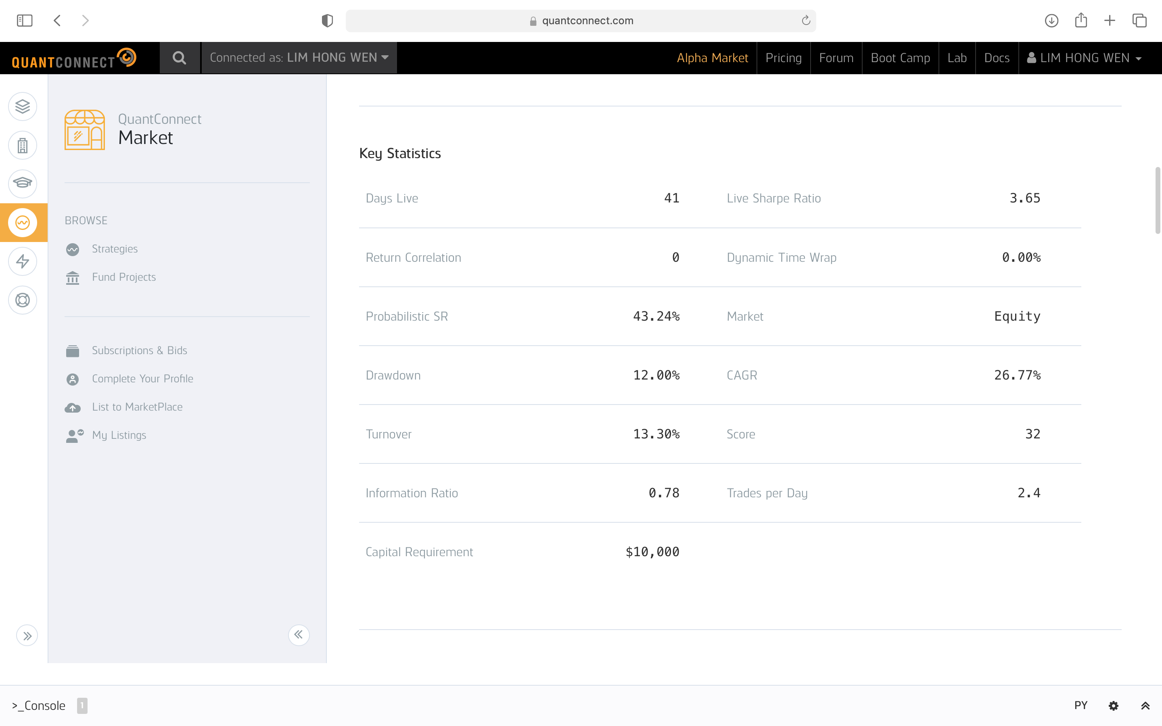
Example of a strategy

Slide 11
4. Our Solution

Slide 12
Our solution
Simple MACD based;
Optimize MACD parameters for 20+ symbols
Trailing stop loss;
Daily
Actively monitor several symbols;
Allocate 3 “best” out of 7 US stocks
Short Term Trading Strategy
Long Term Portfolio Allocation Strategy
SP500 based “11-sector-rebalance”

Slide 13
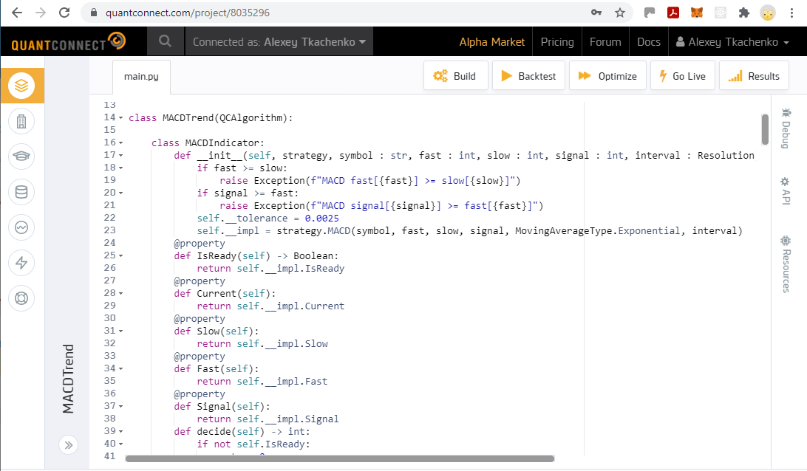
Short term trading strategy
The code is available at Github :
https://github.com/iskaspb/project-omega/blob/master/src/strategy/MACDTrend/main.py

Slide 14
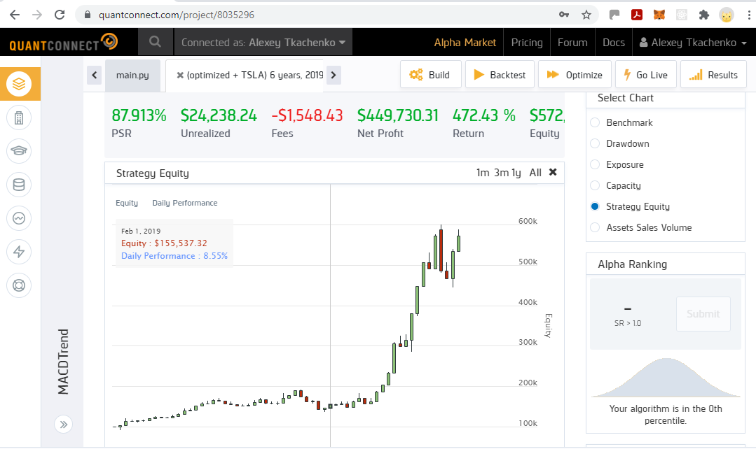
Short term trading strategy backtest

Slide 15
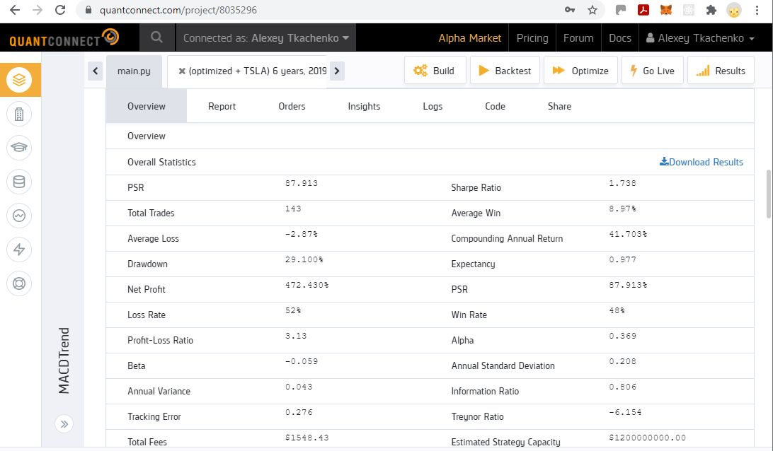
Short term trading strategy backtest

Slide 16
Backtest results
 | Annual Return | Sharpe Ratio | PSR
Short Term Trading Strategy 6 year (3 out of 7 US stocks) | 18.8% | 0.9 | 28%
Short Term Trading Strat (Optimized) 6 years (3 out of 7 US stocks) | 41.7% | 1.7 | 88%
Long Term Portfolio Allocation Strategy 6 years | 14.1% | 0.77 | 23.3%
SP500 6 years | 12.6% | 0.7 | 19.2%

Slide 17
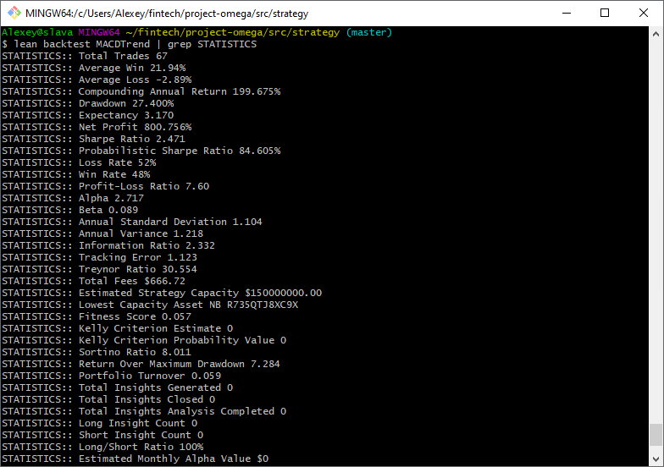
QC Lean : research environment
Benefits
Free of charge;
Automation;
Custom data sources;
Integration with cloud environment;
Convenience of local development and simple to install - see out Github omega-project
QS Lean provides command line interface to all strategy development functions

Slide 18
5. Financials

Slide 19
Financials
48600
Alpha Market Revenue Assumptions
Licensing fee @$3 per month or $36pa per strategy per client (for each 10K invested).
Yr 1
3 strategies with an average of 10 clients each.
Yr 2:
Another 3 strategies added. Total of 6 strategies with an average of 20 clients each.
Yr3
Another 3 strategies added. Total of 9 strategies with an average of 30 clients each
X5
21600
X5
5400
X5
Proprietary trading @20% on $50,000 = $10,000 per annum

Slide 20
Conclusion
Adopted QC Lean and developed set of tools to achieve consistent trading strategy R&D process.
Challenging to develop strategies for Alpha market.
Income from licensing fee strategies not substantial.
Given us insights as investors into algo trading.

Slide 21
Q & A

